Slide 1
Does Violence in Movies Affect You?
By: Garrett Kunde

Slide 2
Are Movies that Violent?

Slide 3
How Does that Violence Affect You?
“exposure to action/violent movies was responsible for juveniles’ delinquency” (Saleem et al. 253)
Brad Bushman et al. talks about a study done where they had weapons on a table or sports gear, the people who saw the weapons reacted with more aggression than anyone else in the study (1015).
And there is a lot more

Slide 4
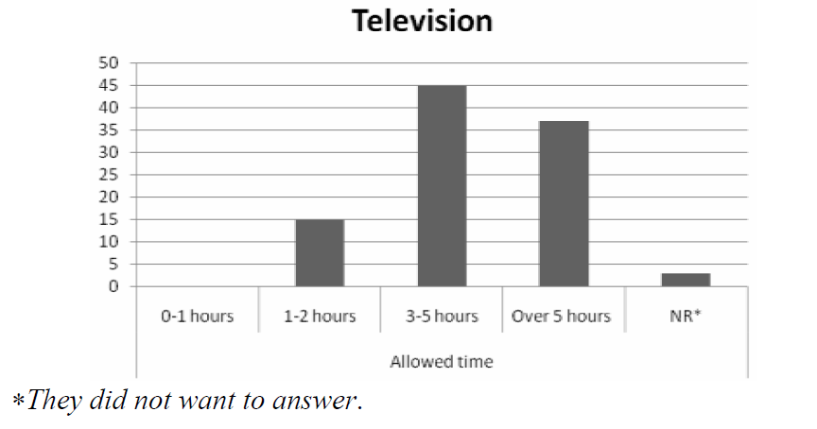
How Often do You Watch Tv or movies?

Slide 5
Becoming an Expert
If you watch 4 hours a day that would be 1,460 hours a year. ‘
That means it would only take you about 7 years to become an expert.

Slide 6
